Slide 1

SPEECH EMOTION RECOGNITION School of Electronics and Communication Engineering
Team members:
SL.NO | NAME | USN
1. | Rahul H Hanumagatti | 01fe20bec324
2. | Asif Musafir | 01fe20bec308
3. | Marigouda | 01fe20bec276
4. | Suhas Gogi | 01fe20bec175
Under the guidance of : Prof. Satish & Prof. Nirmala

Slide 2

Overview ;
Introduction
Literature Survey
Problem statement
Objectives
Functional block diagram
Proposed Methodology
Implementation
Demonstration of results
Optimization
Conclusion
Future Scope
References

Slide 3
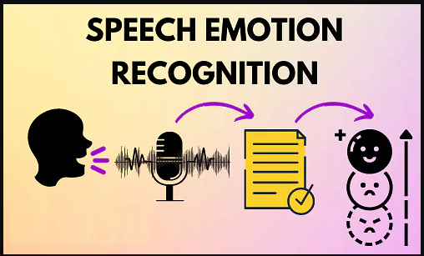
Introduction ;
Emotions are important part of understanding
human interactions.
Research is going into finding methods that can
recognise emotions displayed in the form of changes
in tone while speaking ,Speech Emotion
Recognition (SER) is one of such fields .
Using deep learning and machine learning
algorithms, we aim to design an automatic
emotion recognition system.

Slide 4
Problem statement ;
Speech Emotion Recognition using Machine learning and Deep learning Algorithms.

Slide 5
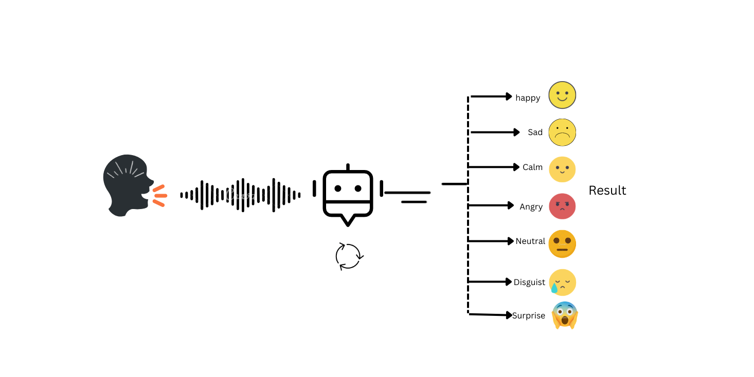
What is Speech Emotion Recognition?
Literature survey ;
Human speech contains several features
that the listener interprets to unpack the rich
information transmitted by the speaker.
The speaker also inadvertently shares tone,
energy, speed, and other acoustic properties,
which helps capture the subtext or intention
and literal words.
LINK FOR LITERATURE SURVEY=https://www.overleaf.com/1213337642pcqdjgvxrjzv

Slide 6


Slide 7
Data Set Information;
(The Ryerson Audio-Visual Database of Emotional Speech and Song (RAVDESS));
Description ;
The Ryerson Audio-Visual Database of Emotional Speech and Song (RAVDESS) contains 7356 files (total size: 24.8 GB).
The database contains 24 professional actors (12 female, 12 male), vocalizing two lexically-matched statements in a neutral North American accent.
Speech includes calm, happy, sad, angry, fearful, surprise, and disgust expressions, and song contains calm, happy, sad, angry, and fearful emotions. Each expression is produced at two levels of emotional intensity (normal, strong), with an additional neutral expression.
All conditions are available in three modality formats: Audio-only (16bit, 48kHz .wav), Audio-Video (720p H.264, AAC 48kHz, .mp4), and Video-only (no sound). Note, there are no song files for Actor_18.

Slide 8
Speech file (Audio_Speech_Actors_01-24.zip, 215 MB) contains 1440 files: 60 trials per actor x 24 actors = 1440.
Video files are provided as separate zip downloads for each actor (01-24, ~500 MB each), and are split into separate speech and song downloads:
File naming convention
Each of the 7356 RAVDESS files has a unique filename. The filename consists of a 7-part numerical identifier (e.g., 02-01-06-01-02-01-12.mp4). These identifiers define the stimulus characteristics:
Modality (01 = full-AV, 02 = video-only, 03 = audio-only).
Vocal channel (01 = speech, 02 = song).
Emotion (01 = neutral, 02 = calm, 03 = happy, 04 = sad, 05 = angry, 06 = fearful, 07 = disgust, 08 = surprised).
Emotional intensity (01 = normal, 02 = strong). NOTE: There is no strong intensity for the 'neutral' emotion.
Statement (01 = "Kids are talking by the door", 02 = "Dogs are sitting by the door").
Repetition (01 = 1st repetition, 02 = 2nd repetition).
Actor (01 to 24. Odd numbered actors are male, even numbered actors are female).

Slide 9
Provided link(Ravdess Dataset);
https://zenodo.org/record/1188976#.Y1EP53ZBxPZ

Slide 10
What is LSTM model (Long Short-Term Memory )?
An LSTM module has a cell state and three gates which provides them with the power to selectively learn, unlearn or retain information from each of the units.
The cell state in LSTM helps the information to flow through the units without being altered by allowing only a few linear interactions.
The LSTM network has three layers, an input layer, a single hidden layer followed by a standard feedforward output layer.

Slide 11
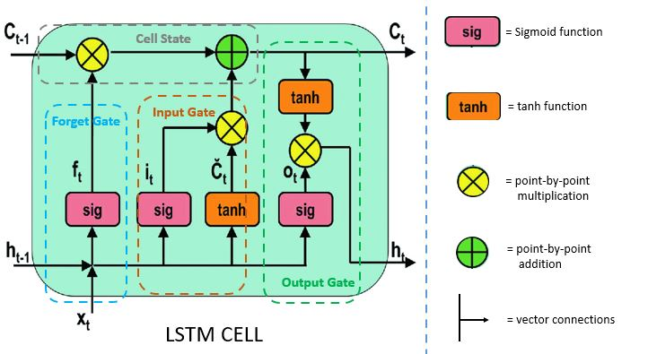
LSTM Model block diagram ;

Slide 12
Purpose of using LSTM model;
LSTM networks are well-suited to classifying, processing and making predictions based on time series data, since there can be lags of unknown duration between important events in a time series.
LSTMs were developed to deal with the vanishing gradient problem that can be encountered when training traditional RNNs.

Slide 13
LSTM model Applications;
Long Short-Term Memory (LSTM) networks are a type of recurrent neural network capable of learning order dependence in sequence prediction problems.
This(LSTM) is a behavior required in complex problem domains like machine translation, speech recognition etc.
LSTMs are a complex area of deep learning.

Slide 14
Features Extracted
Mfccs
Chroma
Contrast

Slide 15
Mel-Frequency Cepstral Coefficients (MFCCs):
It can be derived from a type of inverse Fourier transform(cepstral) representation
Short term power spectrum of any sound represented by the Mel frequency cepstral (MFC) and combination of MFCC makes the MFC
It can be derived by mapping the Fourier transformed signal onto the male scale using triangle or cosine overlapping windows
It can be derived by mapping the Fourier transformed signal onto the male scale using triangle or cosine overlapping windows.
Where after taking the logs of the powers at each of the Mel frequencies and after discrete cosine transform of the Mel log powers give the amplitude of a spectrum. The amplitude list is MFCC.

Slide 16
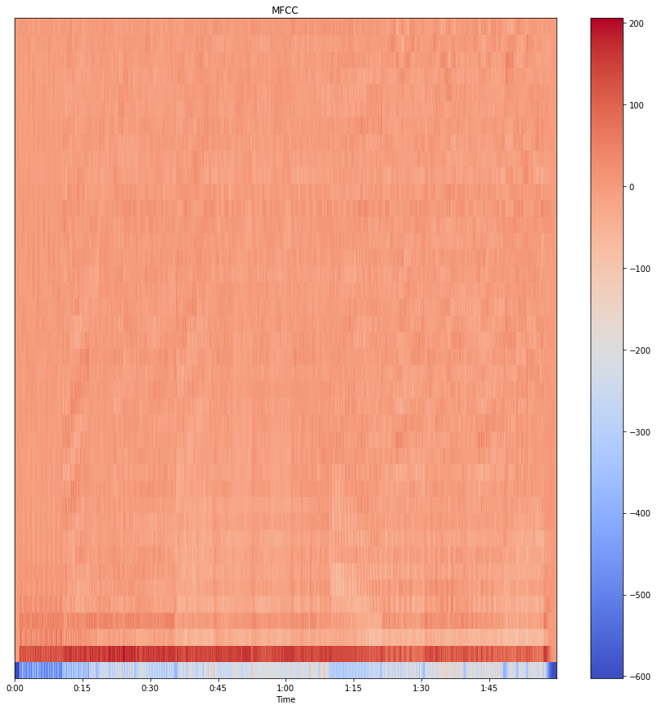
In the above image, we can see the MFCCs

Slide 17
Chroma
The chroma feature is a descriptor, which represents the tonal content of a musical audio signal in a condensed form.
In audio file analysis, an audio file can consist of 12 different pitch classes.
These pitch class profiles are very useful tools for analyzing audio files. The term chromogram represents the pitches under an audio file, in one place so that we can understand the classification of the pitches in the audio files.
Short Time Fourier Transforms and Constant Q Transforms are used for chroma feature extraction.
One main property of chroma features is that they capture harmonic and melodic characteristics of music, while being robust to changes in timbre
The feature vector is extracted from the magnitude spectrum by using a short time fourier transform(STFT),Constant-Q transform(CQT),Chroma Energy Normalized (CENS)

Slide 18
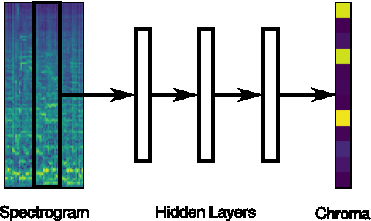
It is some kind of measurement of the quality of the sound which helps in judging the sound as higher, lower, and medium

Slide 19
CONTRAST;
Contrast is the difference in luminance or colour that distinguishes an object (or that item's depiction in an image or display).
The distinction between the visual characteristics of objects in a composition is known as contrast. There are many different methods to use contrast, including through colour, line, shape, form, and context.

Slide 20
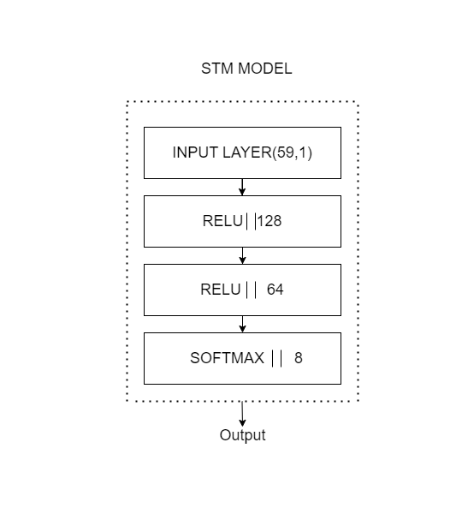
Proposed Methodology

Slide 21
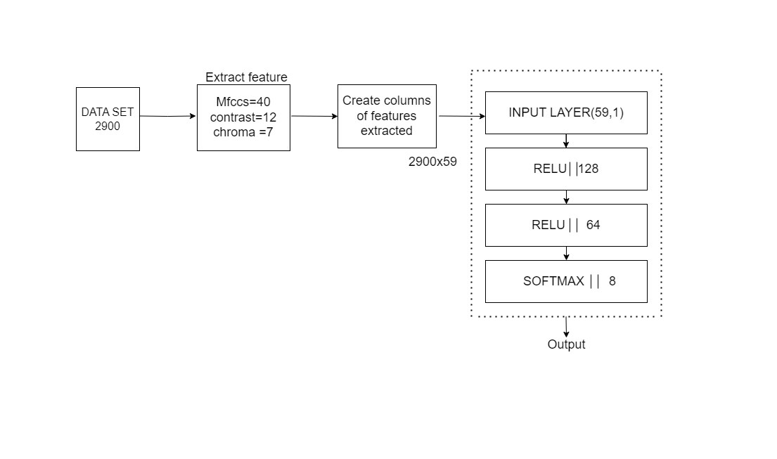
Functional block diagram

Slide 22
THANK YOU

